Slide 1

Welcome to
Year Five
5M – Mrs McGhee
5DR – Mrs Day/Mrs Reeve

Slide 2
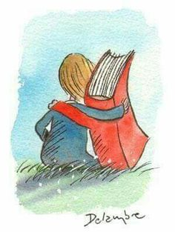
Reading
Our class reading book for autumn 1 is ‘Phoenix’ by S.F Said. Each week will follow this pattern:
Monday - together we read a chapter and children verbally summarise and draw the story
Tuesday - together we explore tricky vocabulary from the chapter
Wednesday - we explore comprehension questions verbally
Thursday - children independently answer the comprehension questions
Friday - a challenge activity related to the chapter or reading the next chapter ready for the following week

Slide 3
Books to read at home:
We use the Big Cat Reading Scheme to promote reading fluency and comprehension
at home.
Children should be reading with an adult at home every day (either Big Cat or
Black Belt). This promotes literacy skills and fosters a love of learning.
As children read and have the opportunity to quiz in school every day, using
Black Belt Reader, school do not require a written a record to prove you are reading
with your child - we trust you to support your child with reading every day for up
to 30 minutes.

Slide 4
Library Books
Children have the opportunity to borrow a book from our library throughout the week.
We use Black Belt Reader (formally Sparx Reader) as the system to log and monitor children’s reading. The children also quiz on the pages they have read, which helps teachers to gauge how well they are understanding the books and support where necessary.

Slide 5
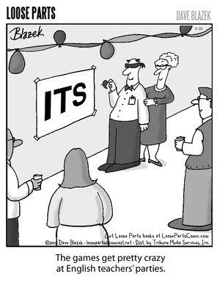
English
Genre: Science fiction, legend, poetry, narrative
Non fiction writing: recounts, persuasion, explanation, discussion
Grammar
Spelling
Handwriting

Slide 6
Spelling patterns
We focus on sounds and building children’s ability to identify patterns that help them spell rather than relying on memorisation or rote learning.
Spelling work takes the form of investigations, quick tasks and working together on a set of focus sounds and spellings.
Every two weeks, we will assess the children’s grasp of the words and patterns we have been examining together across our lessons.
In addition, every child will have a set of five words to focus upon in their work. This allows us to target each child’s individual needs, and to make greater links between spelling and the rest of the work children do in school.

Slide 7
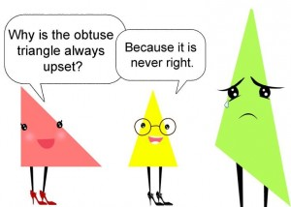
Maths topics:
Place value
Fractions
Decimals
Percentages
Geometry (shape)
Statistics (Data)
Measurement
Formal written methods
Mental maths / arithmetic
Building fluency and developing
reasoning and problem-solving skills

Slide 8








Other subjects
Science: Earth and Space, Living Things and Their Habitats, Animals Including Humans, Properties of Materials, Forces
History: Anglo-Saxons, Vikings, Early Islamic Civilisation
Geography: USA, Japan and Mountains
RE: Christianity, Sikhism and Islam
PE: an outdoor and indoor session each week
Art: Space art, American pop art, Golden Temple, cherry trees, Hokusai and tessellation
DT: Anglo-Saxon jewellery, musical instruments, Viking tapestry, bread / sandwiches, sculpture and magic lamp
Music: ukulele, learning to sing and perform Young Voices songs - the concert is in January 2027. After the concert, lessons will concentrate on listening and composition
French: healthy eating, music, on the way to school, beach, spring and the planets
Computing: Online Safety, Coding, Spreadsheets, Databases, Game creator, 3D modelling

Slide 9
PSHE
This will provide pupils with a chance to discuss their feelings and opinions in a safe environment.
Being Me in my World
Celebrating Difference
Dreams and Goals
Healthy Me
Relationships
Changing Me (Puberty)
Zones of Regulation
A scheme designed to support self-regulation and emotional control

Slide 10
PE
5M need to wear their PE kits on Tuesday and Wednesday
5DR need to wear their PE kits on Tuesday and Friday
Often, PE will take place outdoors so as the weather gets colder, please ensure you child brings in extra layers
If your child needs to miss PE please let us know with an email to admin
If children have pierced ears, ideally earrings should not be worn on PE days. If they must wear them, they need to bring in tape to cover earrings up

Slide 11

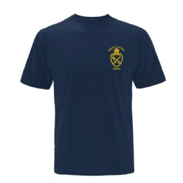
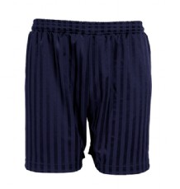
Uniform
Just a reminder:
PE kit should be dark shorts or tracksuit trousers, dark blue plain or school t shirts
Long hair should be tied up at all times
Earrings should not be dangly
All school uniform and coats must be named
No ‘skins’ with uniform please

Slide 12
Home Learning
Is set every Wednesday to be returned by the following Monday and will usually be English or maths based
There is also a half termly project that is set on Google Classroom

Slide 13

Promoting a positive attitude to maths
Model a positive attitude: Avoid saying things like, “I’m not good at maths.” Instead, show curiosity and willingness to learn together.
Mistakes Help Us Learn: Remind your child that mistakes are a natural part of learning and challenges help their brain grow.
Value Effort: Praise your child for working hard and thinking carefully, not just for getting the answers right.
Ask Questions, Don’t Just Give Answers: Guide them with questions like, “What do you notice?” or “Can you try it another way?”
Show Maths in Everyday Life: Cooking, shopping, sports, and games all use maths—help your child see it everywhere.
Celebrate Small Successes: Praise progress, no matter how small, to build your child’s confidence and love of maths.

Slide 14
Anglo-Saxon Day
Anglo-Saxon Day is Friday 6th November 2026 and will be run by History Off The Page. The cost of the day is £15.50.
We would like the children to dress up as Anglo-Saxons. This need not be overly elaborate or expensive. A suggestion sheet will accompany the imminent letter. The office will set up The Gateway for responses.
We would like to hear from parents who can help out – either morning, afternoon, or the whole day. We promise we will not force you to dress up! Please volunteer to help as we cannot run these days without you.

Slide 15
Other trips and visitors
Young Voices - Year 5 children will perform as part of the Young Voices Choir at the O2 Arena on Friday 22nd January 2027.
Hazard Alley Safety Centre on Wednesday 10th March 2027 during the school day.
Lee Valley on Thursday 27th May 2027 during the school day.

Slide 16

Christmas
Our Christmas Carol Concert is planned for 2pm and 5:30pm on Monday 14th December
Tickets will be allocated in a similar way to last year
More details to follow after half term

Slide 17
Communication
Any messages should be sent via the admin email or call the office.

Slide 18
Any questions?

