Slide 1
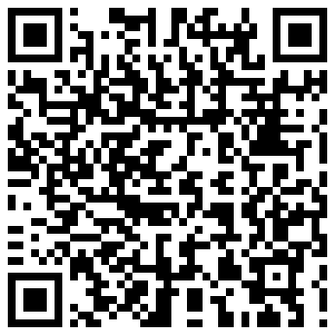
HOLIDAY ACTIVITY PROGRAMME
at Cottonmill Community & Cycle Centre
Old Oak Cottonmill Lane
St Albans AL1 2EF
Join us this Easter
Tuesday 2 to Friday 5 April 2024 11am-3pm each day
For young people aged 13-16
Priority booking for those eligible for benefits-related free school meals
Fun physical activities such as sports, dance and team games
Creative activities such as music production, cooking, arts and crafts.
Informal healthy lifestyles workshops
Meet and socialise with other young people
Free healthy food every day
Use the QR code below or contact
SfYP St Albans Team to sign up. Area Service Manager: Karen Haswell Youth Work Practice Manager: Robert Brown
Tel: 01442 454060 Text: 07860 065195
sfyp.stalbans@hertfordshire.gov.uk
www.servicesforyoungpeople.org
@StAlbansTeam

