Slide 1
Year 6 Residential 17th – 21st June 2024
Norfolk

Slide 2
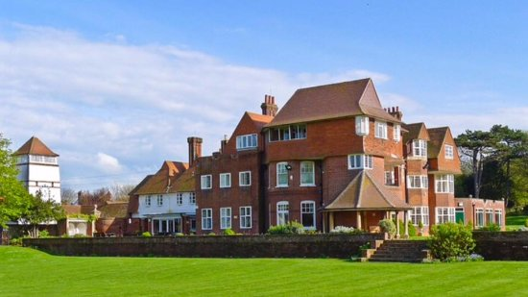
Accommodation
https://www.cehc.org.uk/centres/the-pleasaunce

Slide 3
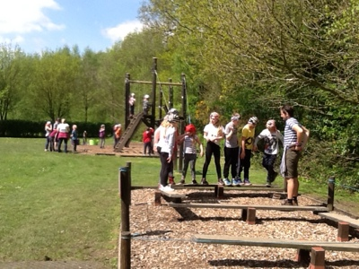
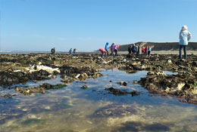
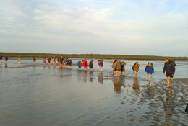
Aylmerton Field Study Centre Field study centre instructors accompany us all week and organise the activities.
https://www.afsc.co.uk/aylmerton-field-study-centre/

Slide 4
Activity timetable example
Monday: Leave Tring approx 8.30am. Arrive at the Pleasaunce and eat lunch. Beach walk and activities - eg sand sculptures . After dinner - twilight safari around the grounds and on the beach. Hot chocolate and bedtime at 9pm.
Tuesday: Field Study Centre- Team building games. Evening trip to local swimming pool.
Wednesday: Boat trip to see the seals at Blakeney. Big Walk from Blakeney nature reserve along coast with a muddy estuary walk to finish. Evening activity – free time.
Thursday: Cromer- Visit church and tower with activities and stories. Walk to visit the lifeboat museum. Visit West Runton to study beach environment. Evening activity - disco.
Friday: Shopping in Cromer - lunch on the beach - coach home.
Arrive home at around 5pm.

Slide 5
Trip details – kit list (to be emailed)

Slide 6
Trip details (forms to be emailed/paper copy)
Parental consent – a form will be sent out in advance of the trip.
Dietary requirements - a form will be sent to you in advance of the trip.
Medicines – medicines, along with the medicine form, are to be brought into school on the morning of the trip and given to a member of staff. Any particularly sensitive issues should be discussed with the class teacher before the morning of the trip.
Electrical devices - Please do not pack any electrical devices including phones. They can bring cameras, books, cuddly toys, small games.
Food - the children only need lunch food, snack and a drink for the first day. Please do not pack them any sweets.

