Slide 1
SATs Information
Notes:
1

Slide 2
What are SATs?
Standard Assessment Tests.
Mandatory KS2 tests.
Take place in classrooms with staff they are used to working with.
Some children will work in other places around the school, depending on individual needs.

Slide 3
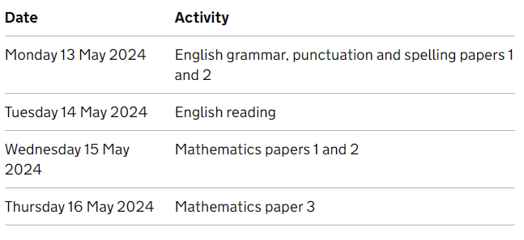
SATs Timetable

Slide 4
SATs Breakfast
The children arrive at school from 8.15am
(Monday 13th- Thursday 16th May)
There will be a selection of cereals, pastries, fruit, toast and a selection of drinks.
There is no charge. Children are free to come on all or any of the mornings.
Parent helpers are needed please!
Please complete volunteer form and return to class teacher.

Slide 5
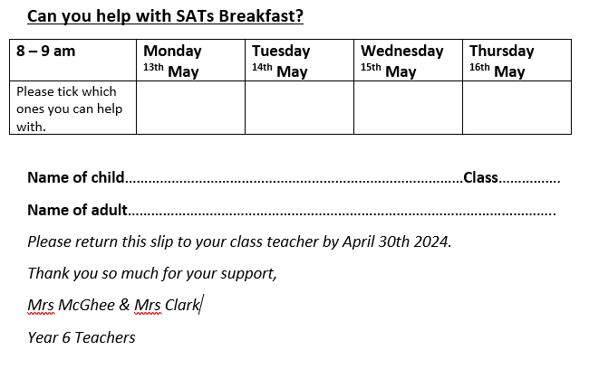

Slide 6
Reminders
Please ensure your children have a restful weekend and sleep well before and during SATs week.
Please don’t plan any holidays or medical appointments if possible, between 13-16th May.
We begin the tests as soon as possible each day. Equipment for the tests will be provided.

Slide 7
Summer Dates
Year 6 play - Matinee:
2pm - Tuesday 9th July 2024
Evening performance: 7pm - Wednesday 10th July 2024
Year 6 Leavers Picnic & BOSCARS:
Thursday 18th July 1-3pm. Family afternoon on the field to celebrate Year 6 and say goodbye.
Year 6 Leavers Disco - Beach Party!
Thursday 18th July 7-9pm

