Slide 1

Welcome to Year Four
4C – Mrs Clark
4A – Mrs Anechite

Slide 2
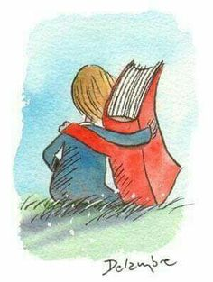
Reading
Our class reading book for autumn 1 is ‘Who Let The Gods Out ’ by Maz Evans. Each week will follow this pattern:
Monday - together we read a chapter and children verbally summarise the story
Tuesday - together we explore tricky vocabulary from the chapter
Wednesday - we explore comprehension questions verbally
Thursday - children independently answer the comprehension questions
Friday - a challenge activity related to the chapter, reading to your teacher, or an opportunity to visit the school library

Slide 3
Reading at Home
We would like you to hear your child read at least three times a week, talk about the story/information and ask them questions - see inside cover of the reading record.
Children should bring their Reading Record to school on Mondays for us to look at
25 reads = bronze award, 50 reads = silver, 75 = gold and 100 reads = platinum. This scheme starts again every term

Slide 4
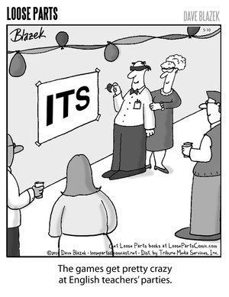
English
Diary
Narrative - linked to Greek Gods
Non fiction writing: recounts, persuasion, explanation, discussion, non-chronological
Grammar
Spelling
Handwriting

Slide 5
Spelling patterns
Last year, we changed our approach to teaching spelling, focusing on sounds and building children’s ability to identify patterns that help them spell rather than relying on memorisation or rote learning.
Spelling work takes the form of investigations, quick tasks and working together on a set of focus sounds and spellings.
Every two weeks, we will assess the children’s grasp of the words and patterns we have been examining together across our lessons.
In addition, every child will have a set of five words to focus upon in their work. This allows us to target each child’s individual needs, and to make greater links between spelling and the rest of the work children do in school.

Slide 6
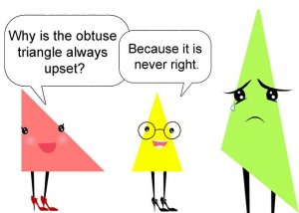
Maths topics:
Mathematics
Number and Place Value
Addition and Subtraction
Multiplication and Division
Fractions (including decimals)
Measurement
Geometry: properties of shape and position and direction
Statistics
Mental maths / arithmetic
Building fluency and developing
reasoning and problem-solving skills

Slide 7
Year 4 Multiplication Table Check (MTC)
Most sure to be taken place at the beginning of June 2026.
The multiplication tables check (MTC) is statutory for all year 4 pupils registered at state-funded maintained schools, special schools or academies, including free schools, in England.
The purpose of the MTC is to determine whether pupils can recall their times tables fluently, which is essential for future success in mathematics. It will help schools to identify pupils who have not yet mastered their times tables, so that additional support can be provided.
It is an onscreen check consisting of 25 times table questions. Your child will be able to answer 3 practice questions before taking the actual check. They will then have 6 seconds to answer each question. On average, the check should take no longer than 5 minutes to completed.
There are several access arrangements available for the check, which can be used to support pupils with specific needs. Your child’s teacher will ensure that the access arrangements are appropriate for your child before they take the check in June.

Slide 8
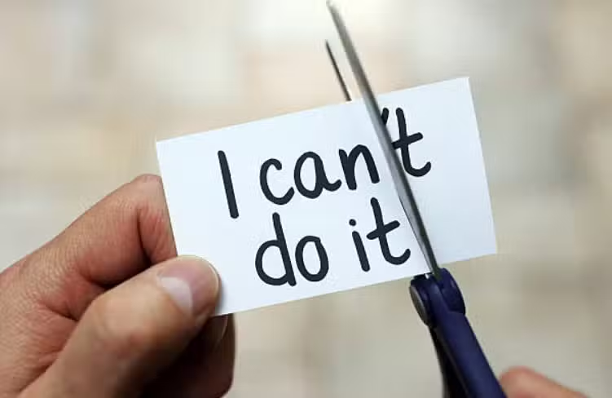
Promoting a positive attitude to maths
Model a positive attitude: Avoid saying things like, “I’m not good at maths.” Instead, show curiosity and willingness to learn together.
Mistakes Help Us Learn: Remind your child that mistakes are a natural part of learning and challenges help their brain grow.
Value Effort: Praise your child for working hard and thinking carefully, not just for getting the answers right.
Ask Questions, Don’t Just Give Answers: Guide them with questions like, “What do you notice?” or “Can you try it another way?”
Show Maths in Everyday Life: Cooking, shopping, sports, and games all use maths—help your child see it everywhere.
Celebrate Small Successes: Praise progress, no matter how small, to build your child’s confidence and love of maths.

Slide 9




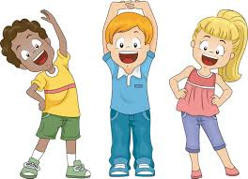
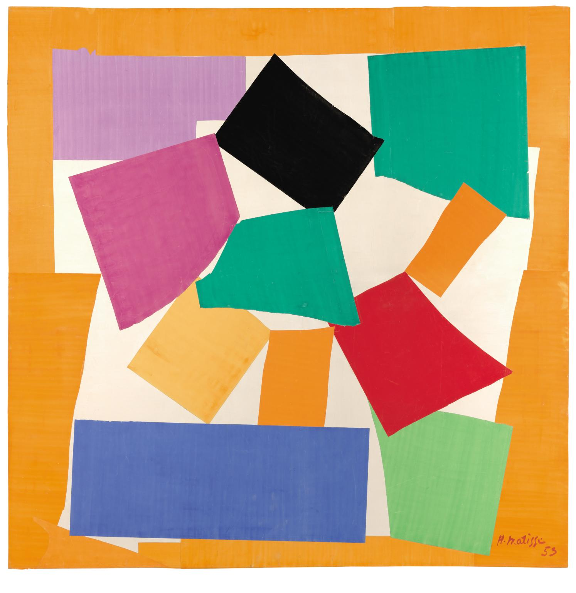


Other subjects
Science:Living things and their habitat, Animals Including Humans, States of matter, Electricity, Sound and Climate Change
History: Ancient Greeks, Roman Britain, Crime & Punishment.
Geography: Uk, Mediterranean, Rivers
RE: Christianity, Humanism, Sikhism
PE: an outdoor and indoor session each week: Swimming, Hockey, Gymnastics, Football, Dance, Athletics, Tag Rugby, Handball/rounders, Netball
Art: Kandinsky - Painting to Music, L.S. Lowry, Roman Mosaics, Degas -Movement in Art, Aboriginal Dot Art, Monet - Rivers
DT: Greek Theatre Masks, Pop-up books, Greek Salad, Press Torches
Music: Rhythmic patterns, develop musical arrangements, listening and composition.
French: Travel, weather, numbers, sports, animals, stories.
Computing: Online Safety, Coding, animation, logo, micro-bits, writing for different purposes

Slide 10
PSHE This will provide pupils with a chance to discuss their feelings and opinions in a safe environment. Being Me in my World Celebrating Difference Dreams and Goals Healthy Me Relationships Changing Me (Puberty) Zones of Regulation A scheme designed to support self-regulation and emotional control

Slide 11
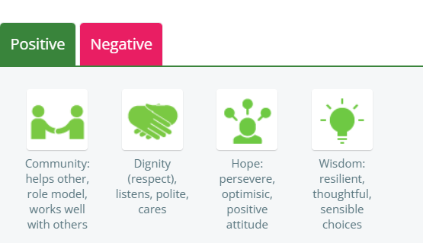
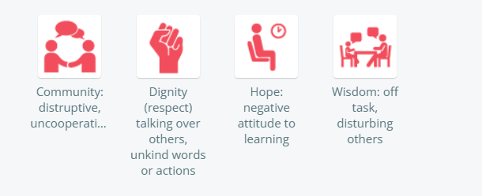
Class charts

Slide 12
Expectations
🤝 Community
Community: Works well with talk partner/group
Community: Helps others without being asked
Community: Takes responsibility for routines
Community: Role model for others
🙌 Dignity (Respect)
Respect: Listens carefully to others
Respect: Polite and respectful language
Respect: Looks after school property/environment
Respect: Resolves disagreements kindly
✅ Positive Behaviours
🌱 Wisdom
Wisdom: Thoughtful contribution in class
Wisdom: Uses feedback to improve work
Wisdom: Shows resilience when challenged
Wisdom: Makes sensible learning choices
🌟 Hope
Hope: Keeps trying, even when it’s hard
Hope: Encourages others to do their best
Hope: Sets goals and works towards them
Hope: Positive attitude to learning

Slide 13
PE
This term, Year 4 only need to wear their PE kits on Tuesday and bring their swimming stuff in on Friday.
Often, PE will take place outdoors so as the weather gets colder, please ensure you child brings in extra layers
If children have pierced ears, ideally earrings should not be worn on PE days. If they must wear them, they need to bring in tape to cover earrings up. Studs only at all times - dangly earrings in a school environment are not necessary and have a risk of danger.

Slide 14
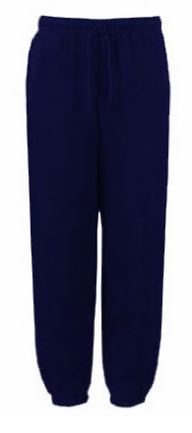
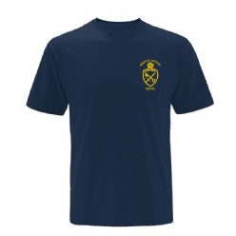
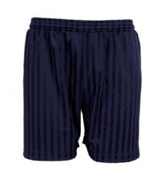
Uniform
Just a reminder:
PE kit should be dark shorts or tracksuit trousers, dark blue plain or school t shirts
Long hair should be tied up at all times
Earrings should not be dangly
All school uniform and coats must be named
No ‘skins’ with uniform please

Slide 15
Home Learning
Is set every Wednesday to be returned by the following Monday and will usually be English or maths based
There is also a half termly project that is set on Google Classroom and stuck into their Home learning books.

Slide 16
Greek Day - Autumn Term
Greek Day is Friday 7th November 2025 (no swimming that day) and will be run by History Off The Page. The cost of the day is approx £14.
We would like the children to dress up as Greeks. This need not be overly elaborate or expensive. A suggestion sheet will accompany the imminent letter. The office are in the process of setting up The Gateway for responses.
We would like to hear from parents who can help out – either morning, afternoon, or the whole day. We promise we will not force you to dress up! Please volunteer to help as we cannot run these days without you.

Slide 17
Other trips and visitors
Spring Term: trip to Roman Verulamium on Friday 13th March 2026
Summer Term: Woodrow High House - 3 days and 2 nights Wednesday 24th June - Friday 26th June 2026

Slide 18
Contacting Us
If you have any concerns, please do contact us. We are available some afternoons at 3.30pm (Monday is staff meeting) for a quick chat but otherwise email / call the office to make an appointment.
We are happy to have you help, especially with reading, if you have the time.

Slide 19
Any questions?
Is there anything you would like to ask that we haven’t covered?

