Slide 1
Year 6 Residential
23rd – 27th June 2025
Norfolk

Slide 2
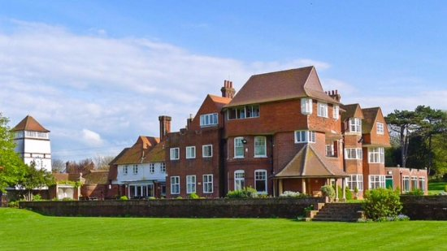
Accommodation
https://www.cehc.org.uk/centres/the-pleasaunce

Slide 3
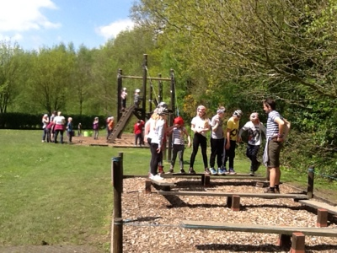
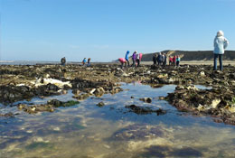
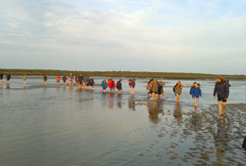
Aylmerton Field Study Centre
Field study centre instructors accompany us all week and organise the activities.
https://www.afsc.co.uk/aylmerton-field-study-centre/

Slide 4
Activity timetable example
Monday: Leave Tring approx 8.30am. Arrive at the Pleasaunce and eat lunch. Beach walk and activities - eg sand sculptures . After dinner - twilight safari around the grounds and on the beach. Hot chocolate and bedtime at 9pm.
Tuesday: Field Study Centre- Team building games. Evening trip to local swimming pool.
Wednesday: Boat trip to see the seals at Blakeney. Big Walk from Blakeney nature reserve along coast with a muddy estuary walk to finish. Evening activity – free time.
Thursday: Cromer- Visit church and tower with activities and stories. Walk to visit the lifeboat museum. Visit West Runton to study beach environment. Evening activity - disco.
Friday: Possible early afternoon arrival time

Slide 6
Trip details (forms to be emailed/paper copy)
Parental consent – a form will be sent out in advance of the trip.
Dietary requirements - a form will be sent to you in advance of the trip.
Medicines – medicines, along with the medicine form, are to be brought into school on the morning of the trip and given to a member of staff. Any particularly sensitive issues should be discussed with the class teacher before the morning of the trip.
Electrical devices - Please do not pack any electrical devices including phones. They can bring cameras, books, cuddly toys, small games.
Food - the children only need lunch food, snack and a drink for the first day. Please do not pack them any sweets.

Slide 7
SATs
Past papers are available on Google Classroom to practice over Easter.
SATs week is Monday 12th May – Thursday 15th May 2025
Monday: SPaG paper (45mins) and spelling test
Tuesday: Reading paper (1hr)
Wednesday: Arithmetic 1 (30mins) and Reasoning Paper 2 (40mins)
Thursday: Reasoning Paper 3 (40mins)

Slide 8
SATs breakfast
Free breakfast from Monday to Thursday every morning at 8am. They enjoy the time with their friends and they are really awake for the tests.
Parent helpers are needed – a letter will go home after Easter

